Slide 1
Declaring War on OUI Drug Prosecutions: The Battle Over Whether Being High is a Lay or Expert Opinion
Presentation by Stuart Hurowitz
(With Huge Help from Attorneys Maura Tansley, Graham Koblenzer, Nathan Wong, Leonardo Angiulo, and Rebecca Jacobstein)

Slide 2
Why is marijuana different?
ALCOHOL
Unlike pharmaceuticals and other drugs, alcohol does NOT attach to specific receptors in the body.
Alcohol is a hydrocarbon so it acts like a solvent.
Impairs the function of MOST receptors in the body as well as plasma membranes and neurons.
Notes:
If SFTS test balance and coordination, how is “failure” when using marijuana different from an alcohol failure?
Innerspace movie
Magic School Bus book – Miss Frizzle?

Slide 3
Why is marijuana different?
ALCOHOL
Directly impacts the cerebellum, frontal lobe changes, heart, liver, diuretic…..
Alcohol has very extensive impact on the body.
Notes:
If SFTS test balance and coordination, how is “failure” when using marijuana different from an alcohol failure?
Innerspace movie
Magic School Bus book – Miss Frizzle?

Slide 4
Why is marijuana different?
MARIJUANA
Cannabis sativa: the plant
Cannabinoids: the psychoactive xenobiotics within the plant aka the toxin.
(1) Delta-9-THC
(2) 11-Hydroxy-THC
(3) cannabidiol
Notes:
If SFTS test balance and coordination, how is “failure” when using marijuana different from an alcohol failure?
Innerspace movie
Magic School Bus book – Miss Frizzle?

Slide 5
Why is marijuana different?
MARIJUANA
Cannabinoids: the psychoactive xenobiotics within the plant aka the toxin.
Specific receptors.
Receptor
Cannabinoid
Notes:
If SFTS test balance and coordination, how is “failure” when using marijuana different from an alcohol failure?
Innerspace movie
Magic School Bus book – Miss Frizzle?

Slide 6
Why is marijuana different?
Where are the receptors?
Frontal lobe – personality
Temporal lobe – speech
Cerebellum – balance and coordination
Receptor
Cannabinoid
Notes:
If SFTS test balance and coordination, how is “failure” when using marijuana different from an alcohol failure?
Innerspace movie
Magic School Bus book – Miss Frizzle?

Slide 7
Why is marijuana different?
What does this mean for actual driving performance versus performance on the SFSTs?
Notes:
If SFTS test balance and coordination, how is “failure” when using marijuana different from an alcohol failure?
Innerspace movie
Magic School Bus book – Miss Frizzle?

Slide 8
Why is marijuana different?
The research.
U.S. Dept. Transportation National Highway and Traffic Safety Administration. “Marijuana and Actual Driving Performance”
Unable to correlate cannabinoid levels with driver impairment. (real-time, on –road driver performance)
What about alcohol?
BAC directly correlates to real-time driver performance.
Notes:
If SFTS test balance and coordination, how is “failure” when using marijuana different from an alcohol failure?
Innerspace movie
Magic School Bus book – Miss Frizzle?

Slide 9
Commonwealth v Gerhardt
Acknowledges there is Scientific correlation between SFTS and alcohol consumption/intoxication.
Acknowledges there is NO scientific correlation between SFTS and Marijuana consumption/intoxication.
But say that it does not mean that the SFTS are not probative beyond alcohol OUI prosecutions.
“Roadside Assessments” are relevant observations by officers.
Can’t say “Pass/Fail” or whether “performance indicated impairment.”

Slide 10
Commonwealth v Gerhardt
Conclusion
We answer the reported questions as follows:
1. "No."
Police officers may not testify to the administration and results of FSTs as they do in operating under the influence of alcohol prosecutions. Police officers may testify to the administration of "roadside assessments" in the manner set forth in this opinion.
2. "No."
A lay witness may not offer an opinion that another
person is "high“ on marijuana.
3. "Yes."
A police officer may testify to observed physical characteristics of the driver such as blood shot
eyes, drowsiness, and lack of coordination. The officer is not permitted to offer an opinion that these characteristics mean that the driver is under the influence of marijuana.
4. "Yes."
Jurors are permitted to utilize their common sense in assessing trial evidence.

Slide 11
Commonwealth v Gerhardt
New Jury Instruction
Finally, evidence of how a defendant performed in roadside assessments, standing alone, is never enough to convict a defendant of operating under the influence of marijuana.

Slide 12
Where Will DRE Fall?
Section 702. Testimony by Experts
Section 701. Opinion Testimony by Lay Witnesses
A witness who is qualified as an expert by knowledge, skill, experience, training, or education may testify in the form of an opinion or otherwise if:
(a) the expert’s scientific, technical, or other specialized knowledge will help the trier of fact to understand the evidence or to determine a fact in issue;
(b) the testimony is based on sufficient facts or data;
(c) the testimony is the product of reliable principles and methods; and
(d) the expert has reliably applied the principles and methods to the facts of the case.
If the witness is not testifying as an expert, the witness’s testimony in the form of opinions or inferences is limited to those opinions or inferences which are
(a) rationally based on the perception of the witness;
(b) helpful to a clear understanding of the witness’s testimony or the determination of a fact in issue; and
(c) not based on scientific, technical, or other specialized knowledge within the scope of Section 702.

Slide 13
Massachusetts Drug Recognition Expert Association
Dec 2017
March 2018
The DEC Program in Massachusetts began in 1995. The program started with just two DREs, and today has grown to
109 certified DREs, 19 of whom are DRE Instructors.
The DEC Program in Massachusetts began in 1995. The program started with just two DREs, and today has grown to
141 certified DREs, 19 of whom are DRE Instructors.

Slide 16
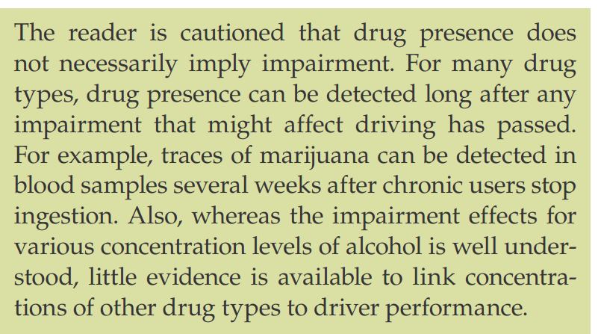

Slide 17
Cannabis

Slide 18
Hallucinogen

Slide 19
Inhalant

Slide 20
Poly Drug

Slide 21
Challenging the Witnesses Qualifications
Mass R Crim P 14(a)(vi) requires identification of any expert and production of at least a CV for that witness
The DRE methodology expressly includes a medical determination
Does the Commonwealth’s expert present a CV with qualifications for making a medical determination?
Use their own standards against them to argue an unreliable application of DRE methodology

Slide 22
https://www.mass.gov/how-to/drug-recognition-expert
ACADEMIC TRAINING: This phase is typically conducted over two weeks (80 hours). It includes courses in pharmacology, physiology, vital signs, standardized field sobriety testing (SFST), as well as extensive material on each of the seven categories of the drugs of abuse. The training includes three written examinations, an SFST proficiency examination and five written quizzes. Students must achieve a minimum of 80% on the three examinations, and must demonstrate proficiency in administering the SFST in order to progress to the certification phase. The academic training is conducted utilizing creative, participant-centered teaching techniques.

Slide 23
https://www.mass.gov/how-to/drug-recognition-expert
CERTIFICATION PHASE: After successfully completing the academic portion, the students return to their department assignment. It is the student's responsibility to complete the certification requirements following the DRE school. These requirements include: conducting a minimum of 12 drug influence evaluations while under the supervision of a DRE instructor; identifying subjects under the influence of three of the seven drug categories; and attaining a 75% toxicological confirmation rate. In addition, the student must maintain a progress log, rolling log and submit a quality resume. Finally, the student must pass a comprehensive final knowledge examination, and be recommended for certification by two DRE Instructors.

Slide 24
https://www.mass.gov/how-to/drug-recognition-expert
FINAL KNOWLEDGE EXAM: Before certification as a DRE, the student must successfully pass a final comprehensive written knowledge exam. This exam tests the students knowledge in all areas of the DRE curriculum. Multiple choice, decision making and essays are all part of this final knowledge exam, which generally takes the student 4-6 hours to complete. The student must then obtain the written endorsement of two certified DRE instructors.

Slide 26
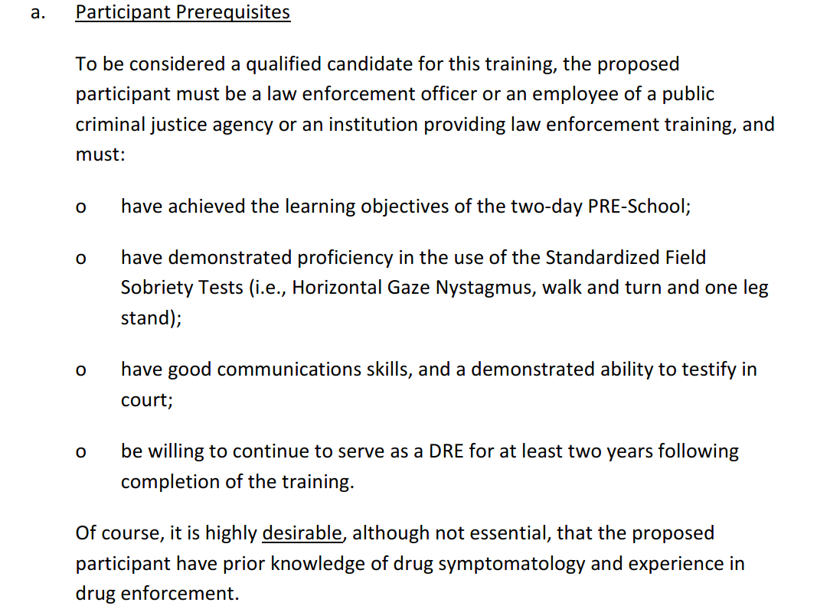

Slide 28
The 12 Step Process
Theory is that the DRE can reach an “opinion that the individual is under the influence of a specific category (or categories) of drugs, DREs utilize a 12 step, systematic and standardized process.”
The DRE will not reach a final opinion until the entire evaluation has been completed
This procedure is rooted in standard medical procedures that are used to reach a diagnosis of illness or injury

Slide 29
The 12-Step DRE Protocol
1. Breath Alcohol Test
The arresting officer reviews the subject’s breath alcohol concentration (BrAC) test results and determines if the subject’s apparent impairment is consistent with the subject’s BrAC. If the impairment is not explained by the BrAC, the officer requests a DRE evaluation.
2. Interview of the Arresting Officer
The DRE begins the investigation by reviewing the BrAC test results and discussing the circumstances of the arrest with the arresting officer. The DRE asks about the subject’s behavior, appearance, and driving.
3. Preliminary Examination and First Pulse
The DRE conducts a preliminary examination, in large part, to ascertain whether the subject may be suffering from an injury or other condition unrelated to drugs. Accordingly, the DRE asks the subject a series of standard questions relating to the subject’s health and recent ingestion of food, alcohol, and drugs, including prescribed medications. The DRE observes the subject’s attitude, coordination, speech, breath and face. The DRE also determines if the subject’s pupils are of equal size and if the subject’s eyes can follow a moving stimulus and track equally. The DRE also looks for horizontal gaze nystagmus (HGN) and takes the subject’s pulse for the first of three times. If the DRE believes that the subject may be suffering from a significant medical condition, the DRE will seek medical assistance immediately. If the DRE believes that the subject’s condition is drug-related, the evaluation continues.
4. Eye Examination
The DRE examines the subject for HGN, vertical gaze Nystagmus (VGN), and a lack of convergence.
5. Divided Attention Psychophysical Tests
The DRE administers four psychophysical tests: the Modified Romberg Balance, the Walk and Turn, the One Leg Stand, and the Finger to Nose test.
6. Vital Signs and Second Pulse
The DRE takes the subject’s blood pressure, temperature, and pulse.
7. Dark Room Examinations
The DRE estimates the subject’s pupil sizes under three different lighting conditions with a measuring device called a pupilometer. The device will assist the DRE in determining whether the subject’s pupils are dilated, constricted, or normal.
8. Examination for Muscle Tone
The DRE examines the subject’s skeletal muscle tone. Certain categories of drugs may cause the muscles to become rigid. Other categories may cause the muscles to become very loose and flaccid.
9. Check for Injection Sites and Third Pulse
The DRE examines the subject for injection sites, which may indicate recent use of certain types of drugs. The DRE also takes the subject’s pulse for the third and final time.
10. Subject’s Statements and Other Observations
The DRE typically reads Miranda, if not done so previously, and asks the subject a series of questions regarding the subject’s drug use.
11. Analysis and Opinions of the Evaluator
Based on the totality of the evaluation, the DRE forms an opinion as to whether or not the subject is impaired. If the DRE determines that the subject is impaired, the DRE will indicate what category or categories of drugs may have contributed to the subject’s impairment.
12. Toxicological Examination
After completing the evaluation, the DRE normally requests a urine, blood and/or saliva sample from the subject for a toxicology lab analysis.

Slide 32
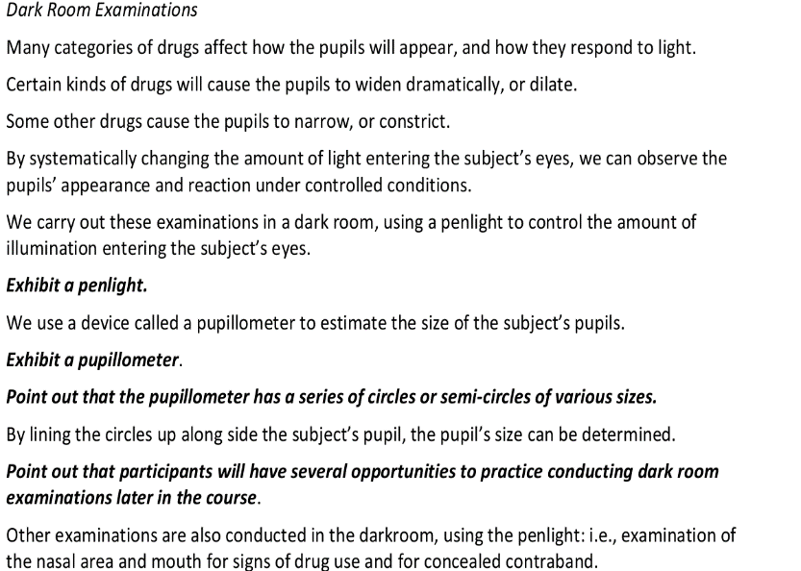

Slide 33
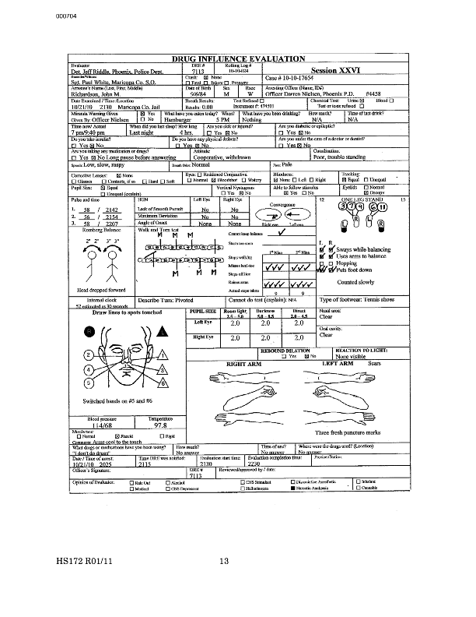

Slide 34
Judge Hinkle 2012 Decision Comm v. Lapaix
At the hearing on admissibility of the DRE testimony, the Commonwealth called only one witness, Trooper Sherher. No evidence was presented regarding whether the relevant scientific community generally accepts that the DRE protocol is a valid test to determine whether or not a person is under the influence of a particular class of drug. No evidence was presented regarding whether the DRE training program is generally accepted by the relevant scientific community as a program that adequately equips DRE officers to give an opinion about whether or not an individual is under the influence of a particular class of drug.
…..
The trooper may testify about the seven steps of the DRE protocol that do not have scientific aspects. If the toxicology testing results are found to be admissible, the trooper may testify that he obtained a urine sample from the defendant that was later tested. The trooper will not he permitted to testify to the three steps of the protocol that have scientific aspects and he will not be permitted to testify about his opinion that the defendant was under the influence of a narcotic analgesic.

Slide 35
What to Do
More Discovery Motions.
Qualifications
Grades
Cost (particularly if they call in the trainors)
Rolling Logs and the Cases that are listed
Identify Experts
Get an Order to Go to the Course with Appropriate Expert

Slide 36
What to Do
Request a Daubert Hearing on OUI Drug Cases With DRE
Ask the Judge to Report Questions
Ask for an Evidentiary Hearing where you can Present Expert Testimony about the relationship between the particular drug and SFSTs, the Science underlying DRE, the Application in the particular case
File a Motion in Limine to Prevent a DRE from giving Expert Opinion Testimony that someone was High or Otherwise Impaired by a Particular Drug based on faulty science.

Slide 37
What to Do
Argue
They Are Not Qualified to Do The Tests
They Are Not Qualified to Testify How The Drugs Interact With the Human Mind and/or Body – And Not Qualified to Explain How It Would Impact FSTs Results
There is No Scientific Correlation Between Drug Ingestion and Performance on any of the FSTs
There is No Scientific Correlation Between Drug Ingestion, Performance on FSTs and Ability to Operate a MV.
There is No Scientific Correlation Between Drug Ingestion, Performance on Other “Steps”, and Ability to Operate a MV
There is an Inherent Cognitive Bias When a “Step” requires an Interview of the Arresting Officer

Slide 38
What to Do
Challenge each and every ‘step’
File Motions to Suppress Evidence within the ‘steps’
FSTs
Statements
Urine Samples
Argue Voluntariness, Lack of Miranda.
Talk with Colleagues.
Litigate, Litigate, Litigate….

