Slide 1
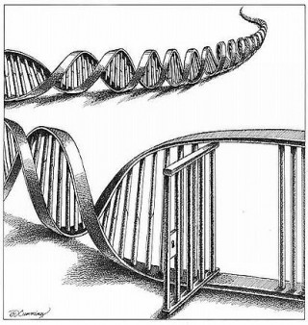
Probabilistic Genotyping
The Newest DNA Test
Ira Gant
Staff Attorney, Innocence Program
Committee for Public Counsel Services
617-607-5771
igant@publiccounsel.net
MACDL Post-Conviction Litigation Seminar
Image credit: www.councilforresponsiblegenetics.org

Slide 2
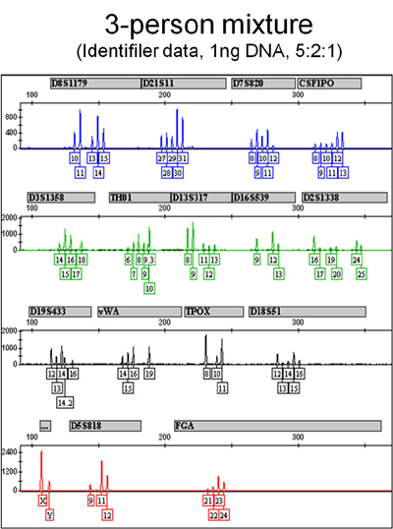
Problems of Interpreting DNA Mixtures
Image credit: nist.gov

Slide 3
Probabilistic Genotyping
Image credit: www.abajournal.com

Slide 4
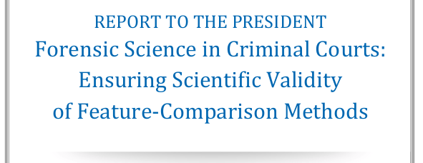
TrueAllele STRmix

Slide 5
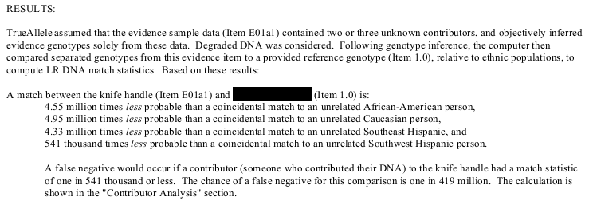
TrueAllele – Sample Results

Slide 6
Get Familiar with Likelihood Ratio
Likelihood Ratio (LR)
A match between the SAMPLE and the DEFENDANT is 8 million times MORE PROBABLE than a random match to an unrelated individual person in the Caucasian population
Different than Random Match Probability (RMP) from standard DNA analysis
The probability of randomly selecting an unrelated individual with this DNA profile is approximately 1 in 8 quadrillion in the US Caucasian population

Slide 7
Some limitations . . .
Likelihood Ratio (LR)
A match between the SAMPLE and the DEFENDANT is 8 million times MORE PROBABLE than a random match to an unrelated individual person in the Caucasian population
Different than Random Match Probability (RMP) from standard DNA analysis
The probability of randomly selecting an unrelated individual with this DNA profile is approximately 1 in 8 quadrillion in the US Caucasian population

Slide 8
Should I seek PG for a MNT?
Is this a strong non-DNA case?
Are you at risk of including your client by a weak LR result?
Understand the lab’s reporting standards:
Does the lab have a cutoff for reporting results?
Understand the language the lab will use to express an exclusion
Do you have access to multiple mixture interpretation software programs?

Slide 9
Should I seek PG for a MNT?
Does prior DNA testing tell you anything about the crime scene evidence?
Number of contributors
Quality of DNA
Do “non-DNA” facts inform your interpretation?
Who should be included in the mixture?
Victim
Alternative Suspects
Relatives
Will the lab run multiple hypotheses?

Slide 10
Challenging Probabilistic Genotyping
TrueAllele excluded
CA: People v. Lee Bell, San Francisco Co. (Apr. 26, 2017) (excluded, in part, over Cybergenetics’ unwillingness to share source code)
Be on the lookout – People v. Billy Ray Johnson, Kern Co., no. BF151825A (appeal pending before Cal. App. Ct., challenging denial for source code)
But…People v. Chubbs, 2015 WL 139069 (Jan. 9, 2015) (reversing trial court’s order to Cybergenetics to release TrueAllele source code)
STRmix excluded
NY: People v. Hillary, St. Lawrence Co., no. 2015-15 (Aug. 26, 2016) (problems with NY State Police’s validation and STRmix’s use of another lab’s validation data)

Slide 11
Challenging Probabilistic Genotyping
How strong was the prosecution’s case?
Was there non-DNA evidence of innocence or non-DNA evidence challenged prosecution theory?
What was the jury told about the DNA evidence?
How was the LR explained?
Was the qualitative scale used?

Slide 12
Either way…
Experts
DNA Analysts
Computer programmers
Statisticians
Population Geneticists (false positive studies)
Test Designers
https://www.strmix.com/
https://www.cybgen.com/

Slide 13
TrueAllele
Admitted in at least eleven jurisdictions:
CA: People v. Langston, Kern Co., no. BF139247B (Jan. 10, 2013)
IN: State v. Forest, Vanderburgh Co., no. 82D03-1501-F2-566 (June 3, 2016)
(maybe) KY: Comm. v. Baldwin, 2018WL296979 (Jan. 25, 2018) (remanded for Daubert hearing)
LA: State v. Chesterfield, Parish of East Baton Rouge, no. 01-13-0316 (II) (Nov. 6, 2014)
MA: Comm. v. Bartlett, Plymouth Co., no. 1283CR157 (May 25, 2016)
NE: State v. Simmer, Douglas Co., no. CR16-634 (Feb. 2, 2018)

Slide 14
TrueAllele
Admitted in at least eleven jurisdictions:
NY: People v. Wakefield, Schenectady Co., no. A-812-29 (Feb. 11, 2015)
Ohio: State v. Shaw, Cuyahoga Co., no. CR-575691 (Oct. 10, 2014)
PA: Comm. v. Foley, Indiana Co., 2012 Pa. Super. 31, no. 2039WDA2009 (Feb. 15, 2012) (aff’d)
TX: Noriega v. State, Harris Co., no. 1435731 (Nov. 14, 2016) (aff’d)
VA: Comm. v. Brady, Colonia Heights Co., no. CR11000494 (July 26, 2013)
WA: State v. Fair, King Co., no. 10-1-09274-5 (Jan. 12, 2017)

Slide 15
STRmix
Admitted in at least six jurisdictions:
(maybe CA): People v. Davis, San Joaquin Co., no. STK-CR-FE-2016-4780 (Dec. 18, 2017)
FL: State v. Cummings, Manatee Co., no. 2016-CF-239 (May 12, 2017)
MI: People v. Muhammad, Muskegon Co., no. 14-65263-FC (Dec. 17, 2015)
MN: State v. Edwards et al., Anoka Co., no. 02CR-17-3290 (Nov. 14, 2017)
NY: People v. Bullard-Daniel, Niagara Co., 42 N.Y.S.3d 714 (Mar. 10, 2016)
TX: Smith v. State, no. 121600139CR, 2017 WL 1534048 (Apr. 28, 2017)
WY: State v. Fairbourn, Sweetwater Co., no. CR16-178-L (Oct. 24, 2017)

Slide 16
Resources
OSAC: Biology/DNA
https://www.nist.gov/topics/forensic-science/biological-data-interpretation-and-reporting-subcommittee
NIST’s STRbase
See “Training Materials” and “Mixture Interpretation”
https://strbase.nist.gov/
Innocence Network Complex DNA Working Group
https://www.yammer.com/complexdnaissuesinnocencenetwork/
SWGDAM
Guidelines for the Validation of Probabilistic Genotyping Systems
https://docs.wixstatic.com/ugd/4344b0_22776006b67c4a32a5ffc04fe3b56515.pdf

Slide 17
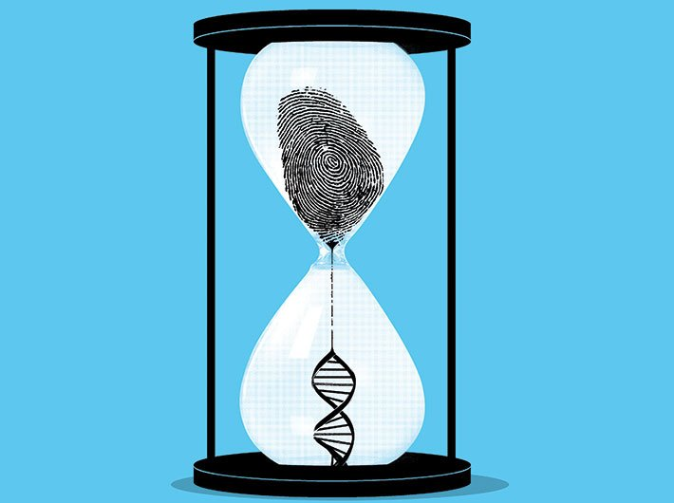
Questions?
Ira Gant
Staff Attorney, Innocence Program
Committee for Public Counsel Services
617-607-5771 igant@publiccounsel.net
Image credit: www.governancenow.com

